Slide 1
An unsupervised framework for effective indexing of Big Data
Ramakrishna Sakhamuri , Dr.Pradeep Chowriappa

Slide 2
Outline:
Introduction.
Objective.
Specific aims.
Project

Slide 3
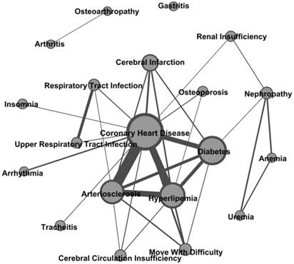
Sample output of a Data Analysis:
Introduction:
http://www.medsci.org/v13/p0099/ijmsv13p0099g003.jpg

Slide 4
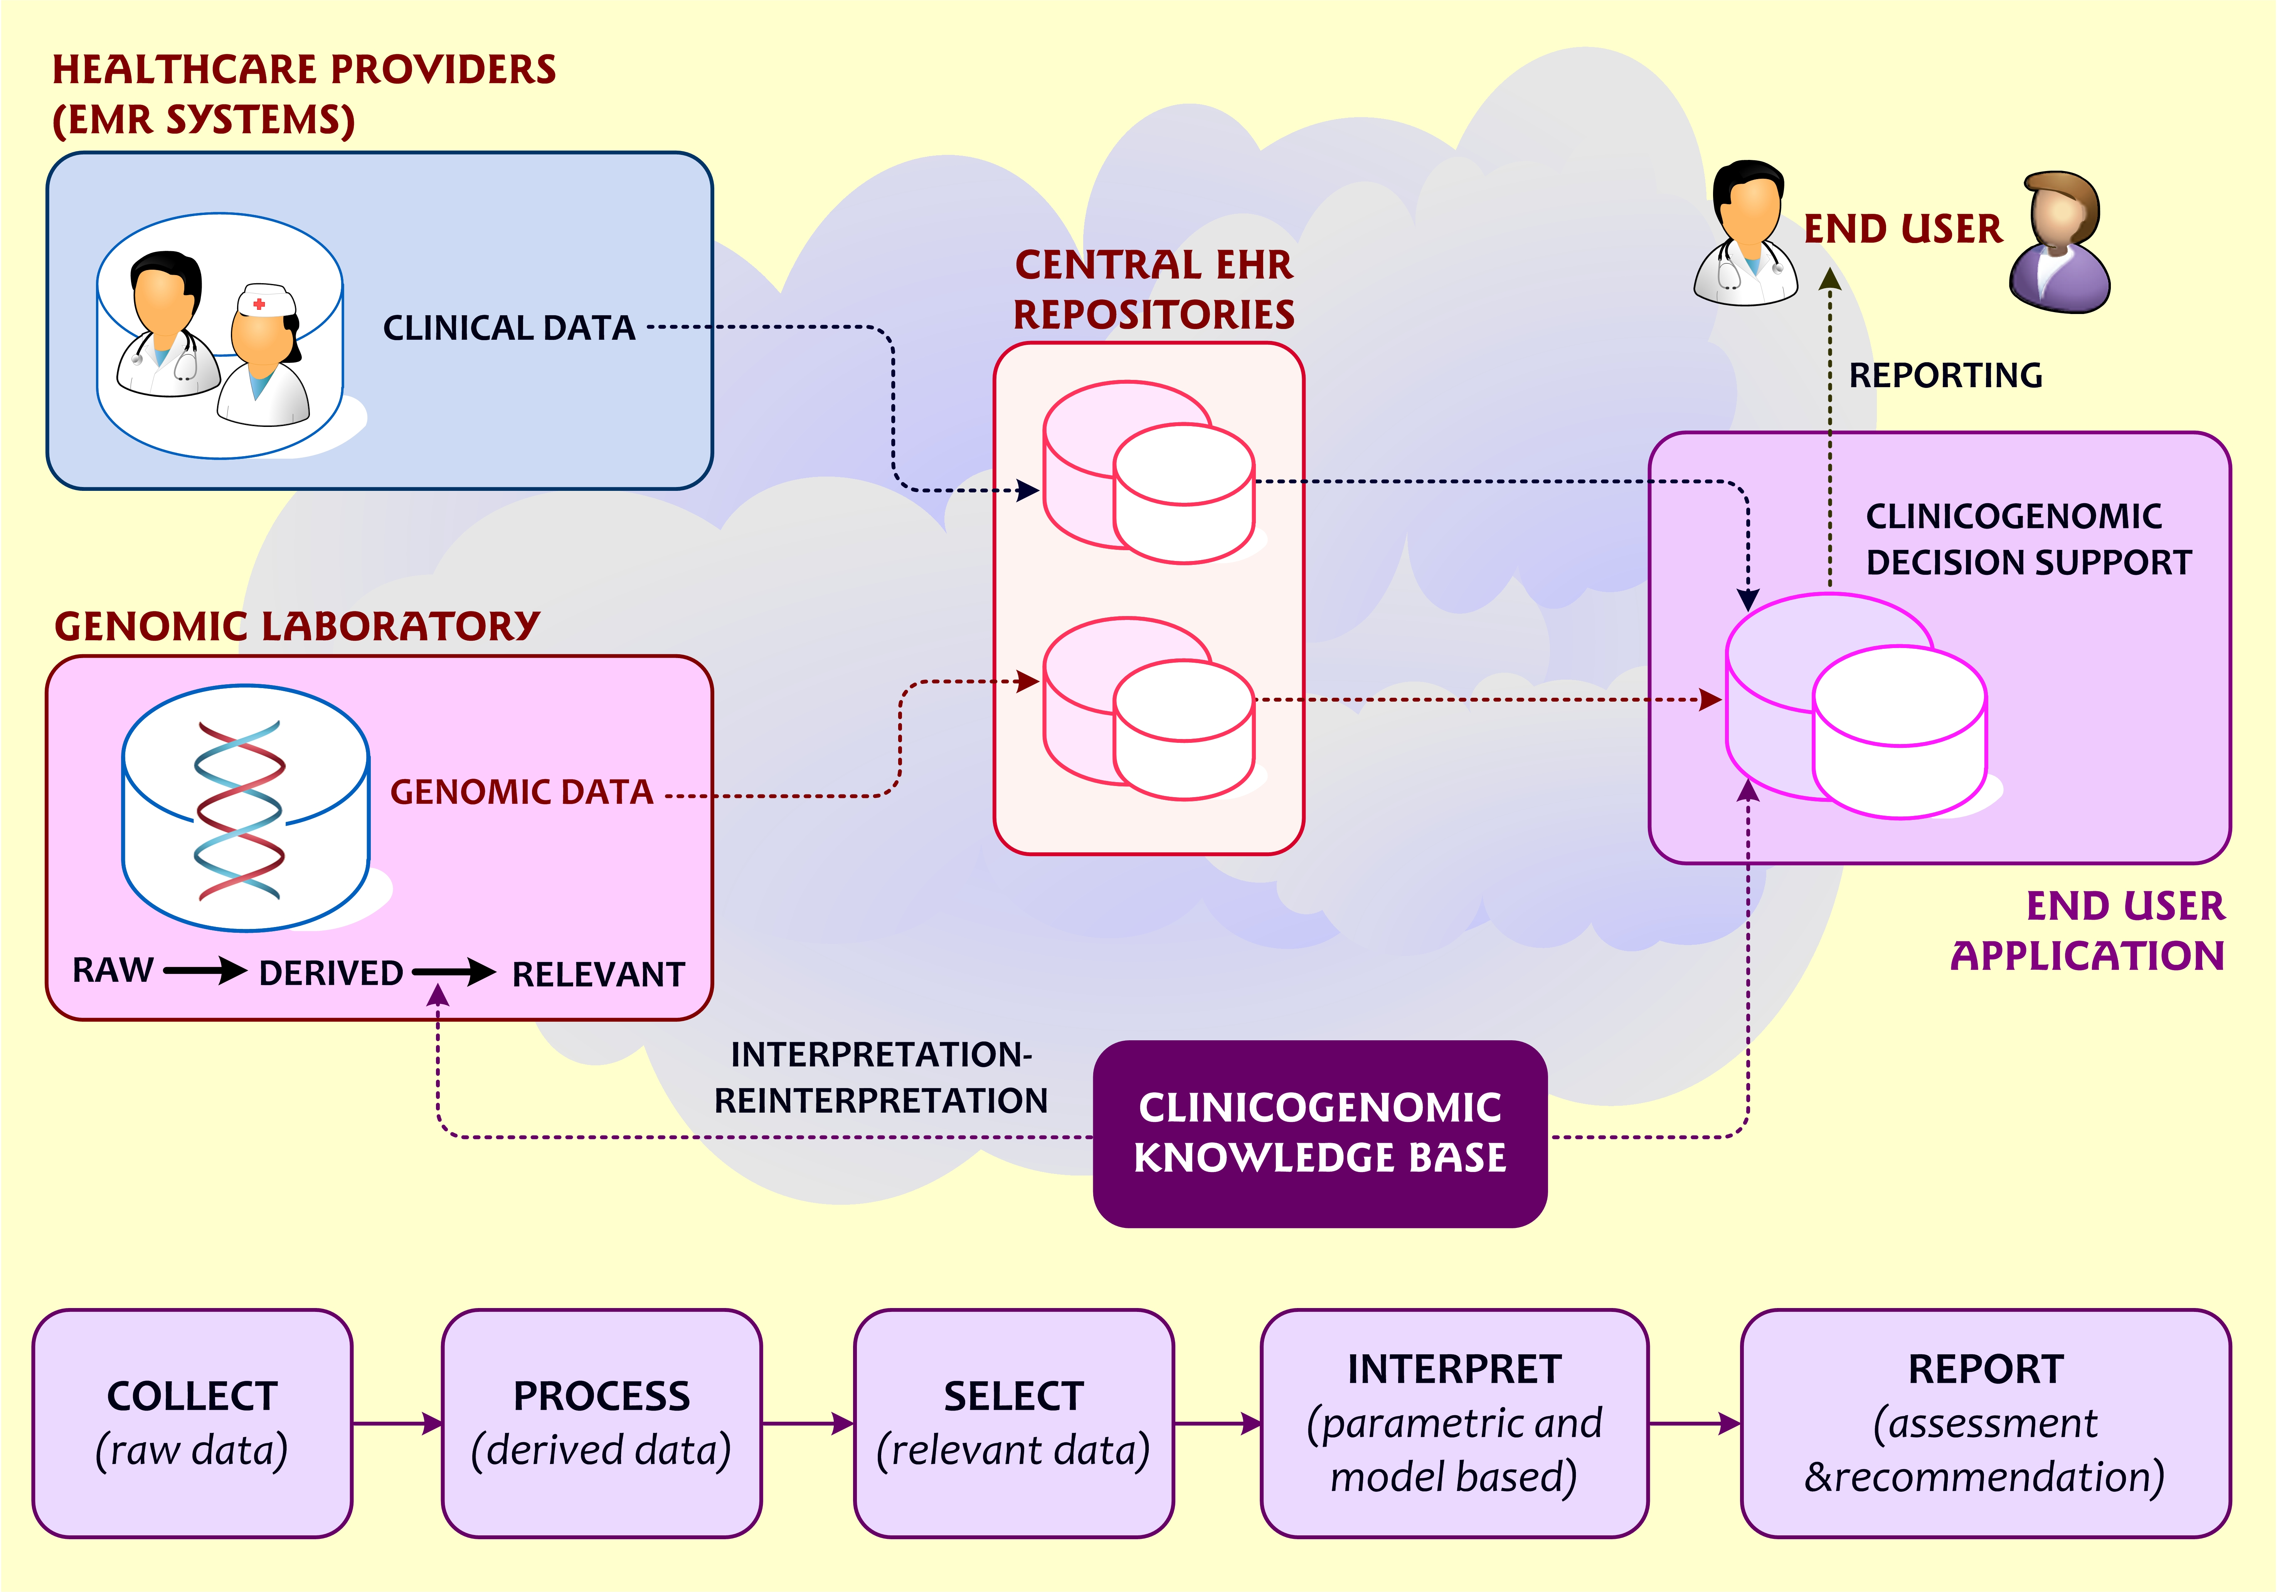
Traditional Decision Making System:
http://www.jmir.org/article/viewFile/3555/1/39724

Slide 5
Indexing:
An index is a systematic arrangement of entries designed to enable users to locate required information.
The process of creating an index is called indexing.
Storage ⬅➔ Indexing.

Slide 6
File System:
Every file system maintains an index tree/table which helps the user to store, parse and retrieve the files.
We can parse a file system in two ways:
Name driven.
Content driven.

Slide 7
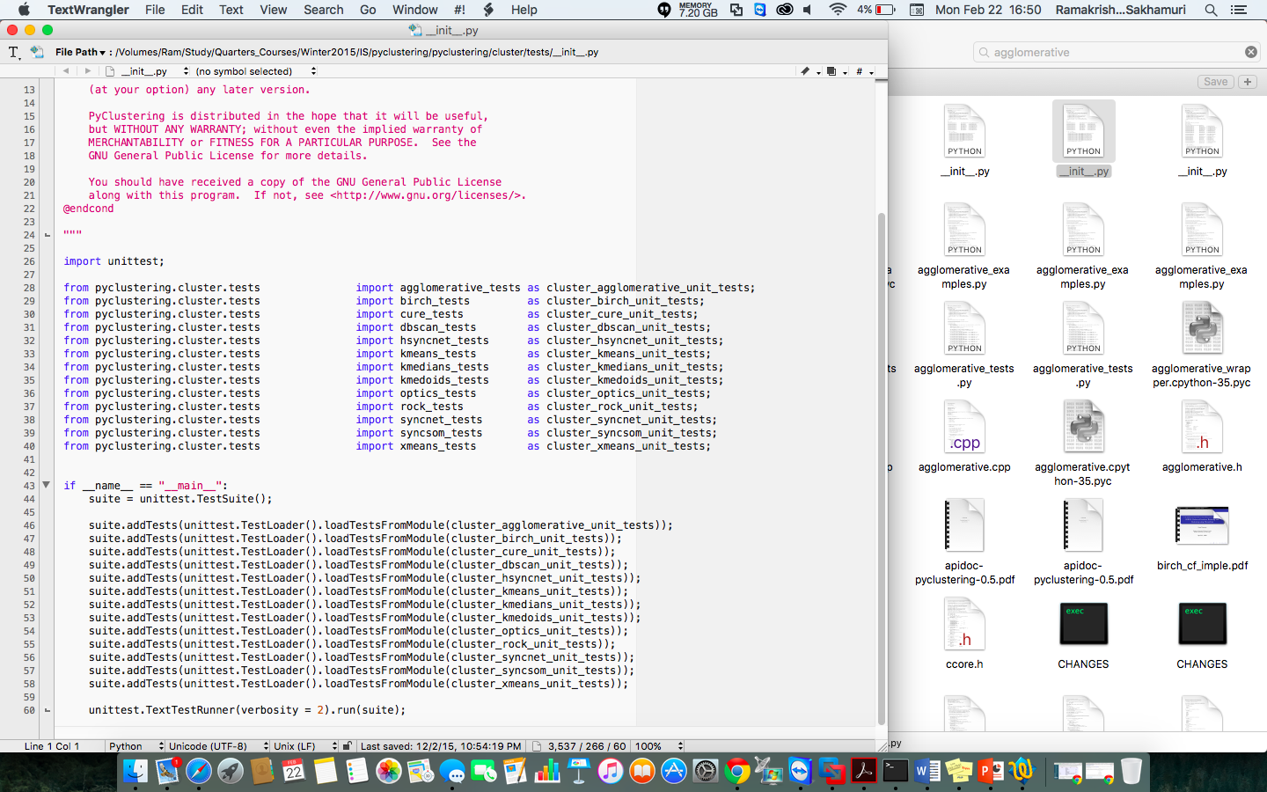
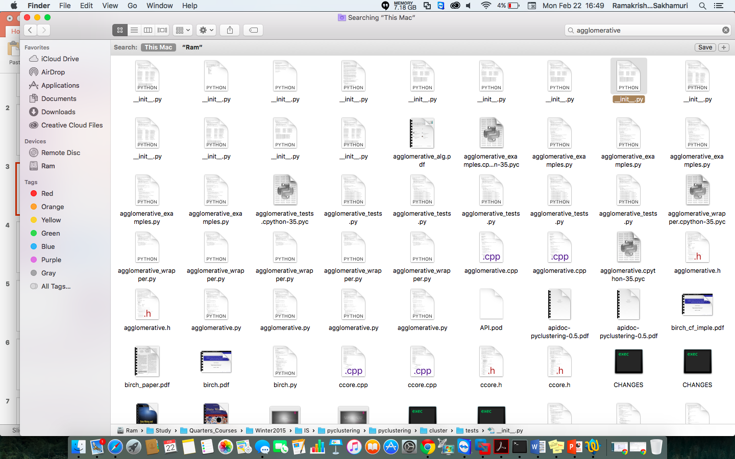

Slide 8
Databases:
Primary Index
Secondary Index

Slide 9
What are we looking at ?

Slide 10
Integration of Indexing and Clustering.
Building a secondary index on top of existing file system index.

Slide 11
Outline:
Indexing
Regular File Systems.
Relational Databases.
Decision Making.
HDFS
BIRCH Algorithm
Project

Slide 12
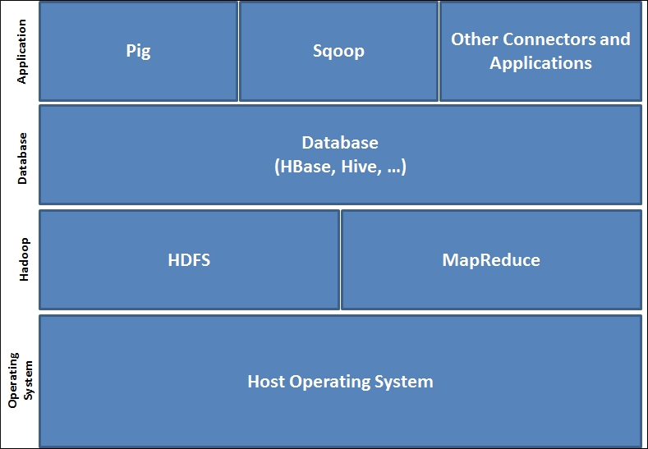
Hadoop System Architecture:
Hadoop is a free, Java-based programming framework that supports the processing of large data sets in a distributed computing environment.

Slide 13
HDFS Architecture:
HDFS stands for Hadoop Distributed Files System, is a filesystem designed for storing very large files with streaming data access patterns, running on clusters of commodity hardware.

Slide 14
BIRCH:
BIRCH stands for Balanced Iterative Reducing and Clustering using Hierarchies.
BIRCH is especially appropriate for very large data sets.
The BIRCH clustering algorithm consists of two main phases.
Phase 1: Build theCF Tree. Load the data in to memory by building a cluster-feature tree (CF tree, defined below). Optionally, condense this initial CF tree into a smaller CF.
Phase 2: Global Clustering. Apply an existing clustering algorithm on the leaves of the CF tree. Optionally, refine these clusters.

Slide 15
Cluster Feature:

Slide 16
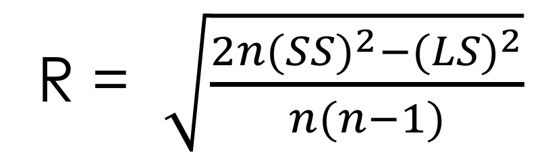
Radius of a cluster:
R = $\sqrt{\frac{2n{(SS)}^{2}−{(LS)}^{2}}{n(n−1)}}$
Radius for any cluster is calculated and compared with the given threshold value. Here is the formulae used in the implementation.

Slide 17
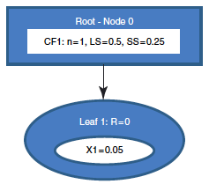
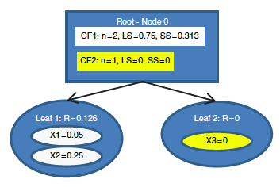
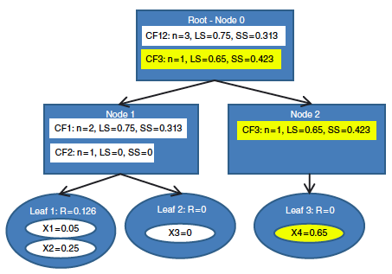
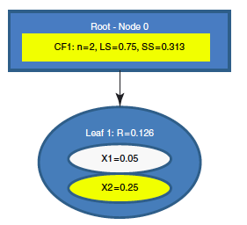
Building a CF tree:

Slide 18
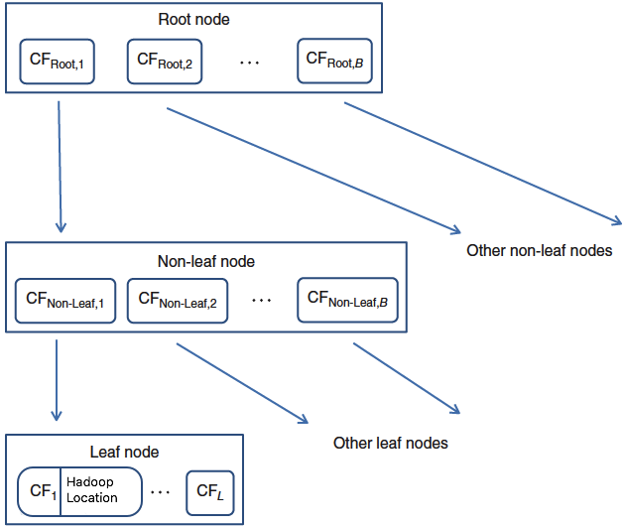
CF Tree structure:
General structure of a CF tree, with branching factor B, and L leafs in each leaf node.
B
L
Larose, D. T. (2015). Data MIning and Predictive Analystics. Wiley.

Slide 19
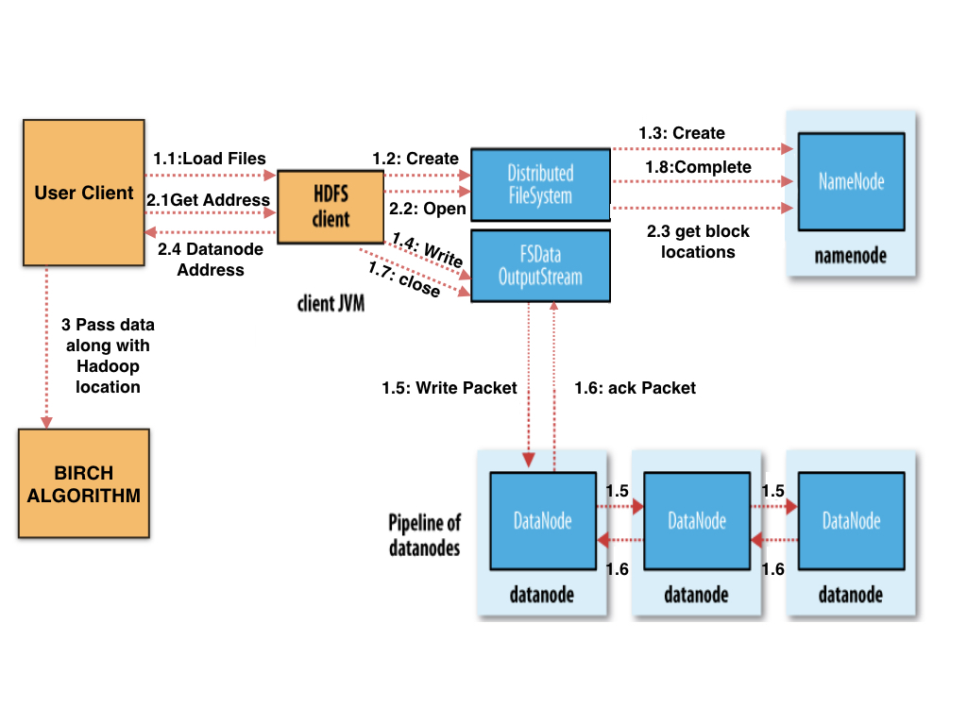
Project:
Writing Files into HDFS.
Pulling the block address information from HDFS.
Passing the address and the data to the BIRCH algorithm.

Slide 20
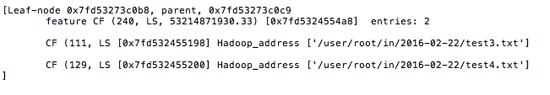
Sample Output

Slide 21
Future Work:
Achieving the Parallelism.
Building an efficient program which can parse the built Index tree and simply works as a search box in regular filesystems.

Slide 22
Project Implementation:
Client.sh | Client.py
Execute the shell script client.sh as a background process. bash $PATH/client.sh > $LOGFILE 2>&1 & This client file handles following steps: It looks for the files in INPUT directory and once it get any files moves them into HADOOP processing directory. Then it loads the data into Hadoop and handshakes Python process to proceed further steps. | Execute the client.py Python script along with the above script. Python $PATH/client.py > $LOGFILE 2>&1 & This script handles following steps: It looks for the Hadoop processed files and once it get those files it pulls the address of those files from HDFS. It gives the data files one by one to birch along with their respective addresses. After every run it writes the entire tree in new file in a predefined location.
Both these scripts are designed to run in the background all the time.

Slide 23
References:
Larose, D. T. (2015). Data MIning and Predictive Analystics. Wiley.
Athman Bouguettaya, Q. Y. (2014). Efficient agglomerative hierarchical clustering. Expert Systems with Applications .
Tian Zhang, R. R. (1996). BIRCH: an efficient data clustering method for very large databases. NY.
https://codemphasis.files.wordpress.com/2012/09/hdfs-arch.jpg
http://www.medsci.org/v13/p0099/ijmsv13p0099g003.jpg
http://www.jmir.org/article/viewFile/3555/1/39724

